Slide 1
Session 5.1 – Annotation
Isabel Cuesta
BU-ISCIII
Unidades Comunes Científico Técnicas – SGSAFI-ISCIII
24 al 28 octubre 2022, 4ª Edición
Programa Formación Continua, ISCIII

Slide 2
Bacterial genome characteristics
A bacterial genome is a single "circular” DNA molecule with several million base pairs in size
Bacteria can contains plasmids (small and circular DNA molecules, that contain (usually) non-essential genes)
Genomes contain a few thousand genes.
”Gene density” is much higher than in humans, one million base pairs of bacterial DNA contains about 500 to 1000 genes.
bacterial genes have no introns,
the average number of codons in bacterial genes is less than in human genes
neighboring genes are very close together throughout the genome
Notes:
El genoma bacteriano es una molecula de DNA circular de tamaños diferentes según especie. Ademas tienen otras moléculas de DNA circular, plasmidos de distintos tamaños y números de copia diferente que generalmente codifican para genes no esenciales. Contienen unos miles de genes en mayor densidad que humano, no hay intrones, generalmente organizados en operones.

Slide 3
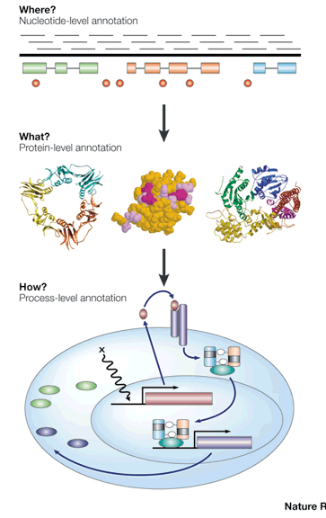
Annotation
Genome annotation is the process of attaching biological (and positional) information to sequences. It consists of three main steps:
identifying portions of the genome that do not code for proteins
Identifying coding elements on the genome, a process called gene prediction
attaching biological information to these elements
https://galaxyproject.github.io/training-material/topics/genome-annotation/tutorials/genome-annotation/tutorial.html
Lincoln Stein, 2001. Nat.Review
Notes:
El proceso de anotación se denomina a la identificación en la secuencia de las regiones que contienen información, zonas que codifican para proteínas, o zonas no codificantes y que función llevan a cabo

Slide 4
Main categories
Structural annotation – Finding genes and other biologically relevant sites with specific locations but unknown function
ORFs
Coding sequences(cds)
Promoters and regulatory regions
Functional annotation – Elements are used in database searches to attach biologically relevant information to whole sequence and individual objects
Notes:
. Es una anotación estructural, identificar regiones, open Reading frames, zonas codificantes o zonas reguladoras, y anotación funcional, asignar función. Lo mas común es asignar función a través de búsqueda en bases de datos.

Slide 5
Automatic annotation
Exponential submission of bacterial genomes
Databases
Uniprot
RefSeq
Encyclopedia of DNA elements (ENCODE)
Entrez Gene
Ensembl
GENCODE
Gene Ontology Consortium (COGs)
GeneRIF
KEGG
Vertebrate and Genome Annotation Project (Vega)
Pfam
etc
https://www.ncbi.nlm.nih.gov/books/NBK20253/#!po=3.12500
Notes:
Un proceso genérico de anotación en genomas bacterianos como el que se realiza cuando subes una secuencia a bbdd como NCBI. Se predicen los genes y se busca homologo en uniprot. Si hay homologo se propaga la información, si no, se queda como putative protein o proteína sin función conocida. Se predicen otros elementos mediante comparación con otras bbdd como las que se listan, dominios pfam, zonas reguladoras Encode etc.

Slide 6
Automatic annotation
Two strategies for identifying coding genes:
Sequence alignment to find known protein sequences in the contigs
transfer the annotation across
will miss proteins not present in your database
may miss partial proteins
Ab initio gene finding o find candidate open reading frames:
Build model of ribosome binding sites
predict coding regions
may choose the incorrect start codon
may miss atypical genes, overpredict small genes
Notes:
Dos estrategias para identificar regiones codificantes. Alinear la secuencia contra secuencias de bases de datos, transferir anotación. Limitacion, solo anotamos la homología encontrada en la bbdd y podemos perder proteínas parciales. Y la segunda es ab initio, buscar regiones de unión de ribosomas e identificar el start y stop codón. Limitación dificultad de elección del codón de inicio y se suelen identificar muchos genes que realmente no codifican para proteína conocida.

Slide 7
Automatic annotation
tRNA: easy to find and annotate: anti-codon
rRNA: easy to find and annotate: 5s 16s 23s
CDS: straightforward to find candidates
false positives are often small ORFs
wrong start codon o partial genes
Pseudogenes
assigning function is the bulk of the workload
Notes:
Se anota automáticamente también las regiones que codifican para tRNA, rRNA y CDS, puede haber muchos ORFs falsos positivos, con codones de inicio erróneos, que no se expresen. Y asignar la función es la parte mas compleja.

Slide 8
Automatic annotation: limitations
If sequence homologous are found, may not be functional homologous
If no homology found- limited information can be inferred
Incorrect annotation can be propagated when similarity is over part on sequence not used in annotation
Multidomain proteins (HMM)
Inconsistent annotation (Different names, same protein)
Same gene name, different product name
Spelling mistakes
Looking for new genes, not present in DDBB
Expression experiments / Manual annotation needed
Richardson and Watson. Briefings in Bioinformatics. 2012
Notes:
Limitaciones que encontramos, ya hemos ido viendo alguna, pero en resumen. Si hay homologo, puede ser de secuencia pero no necesariamente de función. Si no hay homologo, nos quedamos en hipotetical protein. Es posible propagar información incorrecta simplemente por falta de similitud en toda la proteína, por ej. Proteinas multidominio. Hay anotaciones inconsistentes, diferentes nombres para la misma proteína. Problemas en los nombres. Se está limitado a la información que hay en la bbdd. Es necesario mas información biológica, experimental en muchos casos para poder mejorar la anotación y curación de proteínas.

Slide 9
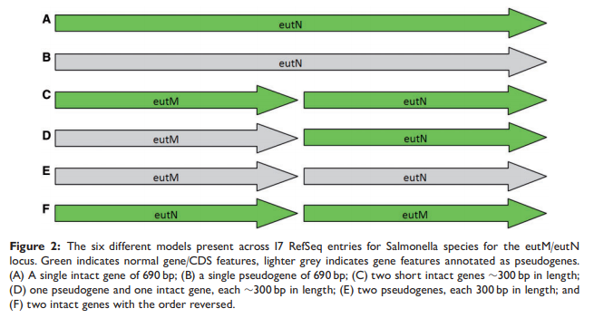
Automatic annotation: limitations
Inconsistent annotation, en un gen descrito evento de fusión genica
Salmonella typhi CT18 (NC_003198) and Salmonella typhi Ty2 (NC_004631) there is a single ORF of 690 bp
Richardson and Watson. Briefings in Bioinformatics. 2012
Notes:
Un ej. De anotación inconsistente. 6 modelos diferentes de anotación presentes en 17 refseq entries para species de salmonella. El gen eutN de 690nt normal y el pseudogen en gris. En el resto de genomas de salmonella hay un codón stop que rompe el gen en dos proteínas. Dos genes cortos normales o un pseudogen y un gen normal para Cy D. O dos pseudogenes o dos genes normales.
Esto es producto de que la anotación se hace por diferentes grupos y se sube a bbdd.

Slide 10
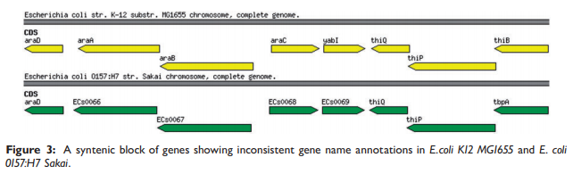
Automatic annotation: limitations
Inconsistent annotation
These two regions are more than 97% identical at the nucleotide level; however, the annotation differs considerably.
While E. coliK12MG1655 contains features with gene names araA, araB and araC, the equivalent features in E. coli 0157:H7 Sakai do not have those gene names and have been assigned uninformative locus tags
Richardson and Watson. Briefings in Bioinformatics. 2012
Notes:
En este caso hay inconsistencia de anotación en un bloque cuya identidad es mayor a 97% en dos genomas de Ecoli, y una de las strains tiene claramente anotado los nombres de los genes y en la otra strain no se propaga ese nombre, se utiliza locus tags no informativos.

Slide 11
Automatic annotation: limitations
Spelling mistakes
There are 128 proteins in UniProt that contain the word ‘syntase’, an incorrect spelling of the word ‘synthase’
If a user was to visit any of these databases and search for ‘dihydrofolate synthase’ the misspelled entries would be omitted from the search results
Richardson and Watson. Briefings in Bioinformatics. 2012
Notes:
Hay errores en la escritura del nombre de la proteína que introduce inconsistencias. En las búsquedas supondría no encontrar todas las entradas de la bbdd buscando por un nombre que tenga errores de escritura.

Slide 12
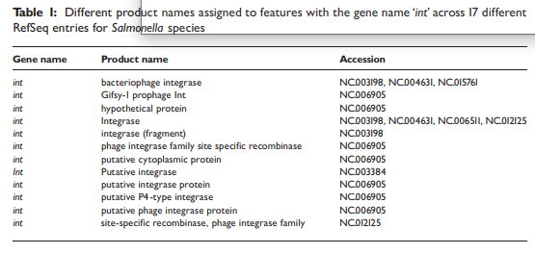
Automatic annotation: limitations
‘Same gene name, different product name’
The NCBI validation software specifically highlights when this occurs intra-genomically with the description ‘Same gene name, different product name’
Richardson and Watson. Briefings in Bioinformatics. 2012
Notes:
Mismo nombre diferente producto genico

Slide 13
Automatic annotation: limitations
Hypothetical proteins
These may be real genes with no known function or they may be artifacts of the gene prediction process.
Often there are features which are only orthologous to other hypothetical features and do not contain any domains. These could either be regions with no functionality, a relic of the feature prediction software or the domains present have not been discovered yet
Whether or not to include them is often a decision made by the annotation team and varies between groups
As experimental data becomes more ubiquitous evidence tags should play a larger role in annotation.
Richardson and Watson. Briefings in Bioinformatics. 2012
Notes:
Las hipotétical proteins pueden ser verdaderos genes sin función conocida o artefactos. A veces hay homología con una proteína pero no se identifican dominios funcionales. Esto depende claramente del aumento de evidencia a través de datos experimentales que permitan asignar funciones a genes o proteínas con función desconocida

Slide 14
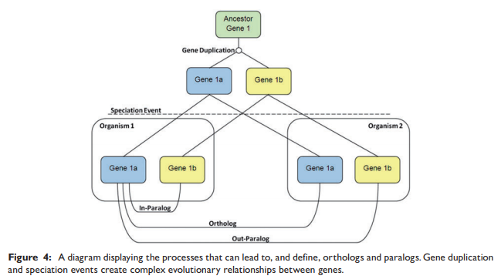
Automatic annotation: limitations
Distinguishing orthologs from paralogs
orthologs tend to retain similar functions, whereas paralogs tend to diverge over time to
perform different functions
Richardson and Watson. Briefings in Bioinformatics. 2012
Notes:
Otra limitación es distinguir ortólogos de paralogos. El ortólogo suele retener función similar, el paralogo suele evolucionar a la perdida de función o función diferente.

Slide 15
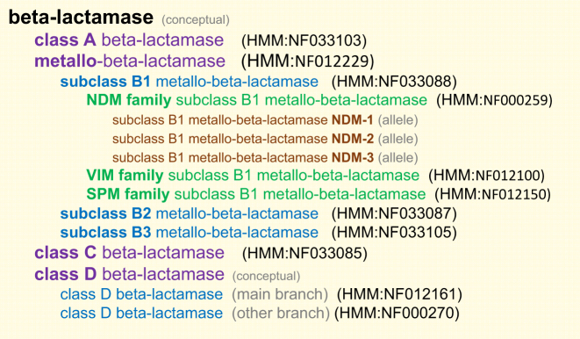
Automatic annotation: limitations
RefSeq is one attempt to standardize and improve the quality of genome annotation
WP_ prefix. All identical proteins regardless of species
Standard classification
Notes:
La etiqueta Refseq se pone o se considera una proteína o secuencia Refseq cuando ha sido curada con el objetivo de tener un standard algo fiable sobre lo que fijarse y propagar anotación.

Slide 16
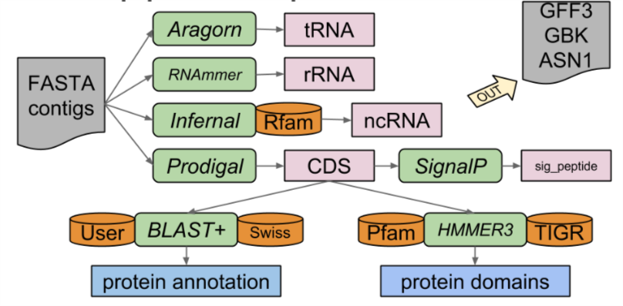
Automatic annotation: Prokka (Rapid prokaryotic genome annotation)
Seeman, Bioinformatics 2014
Tool (reference) | Features predicted
Prodigal ( Hyatt 2010 ) | Coding sequence (CDS)
RNAmmer ( Lagesen et al. , 2007 ) | Ribosomal RNA genes (rRNA)
Aragorn ( Laslett and Canback, 2004 ) | Transfer RNA genes
SignalP ( Petersen et al. , 2011 ) | Signal leader peptides
Infernal ( Kolbe and Eddy, 2011 ) | Non-coding RNA
BLAST+ ( Camacho et al. , 2009 ) | Specific function or name
 | Personal database
https://galaxyproject.github.io/training-material/topics/genome-annotation/tutorials/annotation-with-prokka/slides.html#8
Notes:
Prokka, rapid prokaryotic genome annotation, es un software de anotación que incorpora diferentes softwares que anotan cada una de las features

Slide 17
Automatic annotation: Prokka
Optional user-provided set of annotated proteins
All bacterial proteins in UniProt
All proteins from finished bacterial genomes in RefSeq
Hidden Markov model profile databases, Pfam and TIGRFAMs
Hypothetical protein
Prokka uses this method, but in a hierarchical manner, starting with a smaller trustworthy database, moving to medium sized
but domain-specific databases, and finally to curated models of protein families
Notes:
Prokka funciona con un método jerarquico de búsqueda partiendo de bases de datos de confianza aportada por usuario a búsqueda en uniprot, refseq y dominios. Si no encuentra la deja como hipothetical protein.

Slide 18
Automatic annotation: Prokka
Facts
searching against smaller databases is faster
searching against similar sequences is faster
Idea
start with small set of close proteins
advance to larger sets of more distant proteins
Prokka
your own custom "trusted" set (optional)
core bacterial proteome (default)
genus specific proteome (optional)
whole protein HMMs: PRK clusters, TIGRfams
protein domain HMMs: Pfam
Prokka uses this method, but in a hierarchical manner, starting with a smaller trustworthy database, moving to medium sized
but domain-specific databases, and finally to curated models of protein families
Notes:
Debido a que buscar en bbdd pequeñas y de secuencias cercanas es mas rápido, la idea de prokka es usar un set de datos de proteínas cercanas y después ampliar la anotación usando un set mayor de proteínas mas lejanas en homología. Se puede incorporar el propio set de secuencias, se trabaja sobre un core de proteínas de bacterias, comunes a todas, es opcional usar especifica de genero y anota dominios mediante HMMs.

Slide 19
Prokka: Sequence databases
I'll just BLAST against the non-redundant database. -- Anonymous
● Which one?
nucleotide (nt) or protein (nr)
It's actually quite redundant o only eliminates exact matching sequences
It's not picky o nearly anything is admitted, garbage in garbage out
● It's too big o searching takes too long
Notes:
Hacemos blast contra una bbdd y lo que hay en bbdd es lo que obtenemos

Slide 20
Prokka: Sequence databases
Prokka uses this method, but in a hierarchical manner, starting with a smaller trustworthy database, moving to mediumsized but domain-specific databases, and finally to curated models of protein families. By default, an e-value threshold of 10⁶ is used with the following series of included databases:
Optional user-provided set of annotated proteins
All bacterial proteins in UniProt
All proteins from finished bacterial genomes in RefSeq
Hidden Markov model profile databases, Pfam and TIGRFAMs
Hypothetical protein
Notes:
Hacemos blast contra una bbdd y lo que hay en bbdd es lo que obtenemos

Slide 21
Automatic annotation: Prokka
Core Bacterial proteome
Many bacterial proteins are conserved
experimentally validated
good annotations
Prokka provides this database
derived from UniProt-Swissprot
only bacterial proteins
only accept evidence level 1 (aa) or 2 (RNA)
reject "Fragment" entries
extract /gene /EC_number /product /db_xref ●
First step gets ~50% of the genes
BLAST+ blastp, multi-threading to use all CPUs
Notes:
Porque se justifica usar un core de proteínas, muchas proteínas bacterianas están conservadas, hay validación experimental y tienen anotación. La información la extrae de Uniprot – swissprot que es la Refseq de uniprot, solo proteínas bacterianas con nivel de evidencia a nivel de aminoácido y de expresión, rechaza fragmentos y extrae la anotación de gen, id en caso de enzima, product o id en otras dbs. Hace un blastp y captura en una primera instancia aprox 50% de genes anotados

Slide 22
Automatic annotation: Prokka
Prokka has genus specific databases
aim to capture "genus specific" naming conventions
derived from proteins in completed genomes
proteins are clustered and majority annotation wins
some annotations are rubbish though
Custom model databases
I took COG/PRK MSAs and made HMMs
Existing model databases
Pfam, TIGRfams are well curated
And if all else fails
we always have our friend "hypothetical protein"
Notes:
Se tiene la opción de usar proteoma de genero, derivado de genomas completos, y se propaga la anotación mas representada. Usa modelos de dbs para dominios.

Slide 23
Automatic annotation: Prokka output
Suffix | Description of file contents
.fna | FASTA file of original input contigs (nucleotide)
.faa | FASTA file of translated coding genes (protein)
.ffn | FASTA file of all genomic features (nucleotide)
.fsa | Contig sequences for submission (nucleotide)
.tbl | Feature table for submission
.sqn | Sequin editable file for submission
.gbk | Genbank file containing sequences and annotations
.gff | GFF v3 file containing sequences and annotations
.log | Log file of Prokka processing output
.txt | Annotation summary statistics
Notes:
Los ficheros que genera la anotación son:

Slide 24
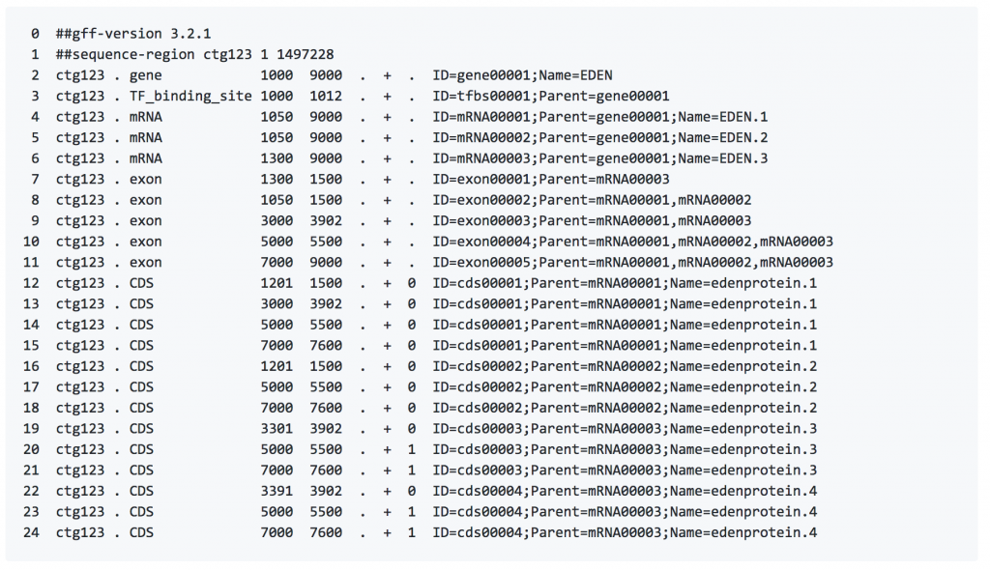
Annotation format: gff3
Seqid - name
Source - program
Type – term or SOFA sequence ontology
Start
End
Score
Strand – (+/-)
Phase – (0/1/2)
Attributes
Name
Alias
Parent
Target
Gap
Derives_from
Note
Dbxref
Ontology_term
Notes:
Column 9 Tags
Column 9 tags have predefined meanings:
ID
Indicates the unique identifier of the feature. IDs must be unique within the scope of the GFF file.
Name
Display name for the feature. This is the name to be displayed to the user. Unlike IDs, there is no requirement that the Name be unique within the file.
Alias
A secondary name for the feature. It is suggested that this tag be used whenever a secondary identifier for the feature is needed, such as locus names and accession numbers. Unlike ID, there is no requirement that Alias be unique within the file.
Parent
Indicates the parent of the feature. A parent ID can be used to group exons into transcripts, transcripts into genes, and so forth. A feature may have multiple parents. Parent can *only* be used to indicate a partof relationship.
Target
Indicates the target of a nucleotide-to-nucleotide or protein-to-nucleotide alignment. The format of the value is "target_id start end [strand]", where strand is optional and may be "+" or "-". If the target_id contains spaces, they must be escaped as hex escape %20.
Gap
The alignment of the feature to the target if the two are not collinear (e.g. contain gaps). The alignment format is taken from the CIGAR format described in the Exonerate documentation. http://cvsweb.sanger.ac.uk/cgi-bin/cvsweb.cgi/exonerate?cvsroot=Ensembl). See the GFF3 specification for more information.
Derives_from
Used to disambiguate the relationship between one feature and another when the relationship is a temporal one rather than a purely structural "part of" one. This is needed for polycistronic genes. See the GFF3 specification for more information.
Note
A free text note.
Dbxref
A database cross reference. See the GFF3 specification for more information.
Ontology_term
A cross reference to an ontology term. See the GFF3 specification for more information.

Slide 25
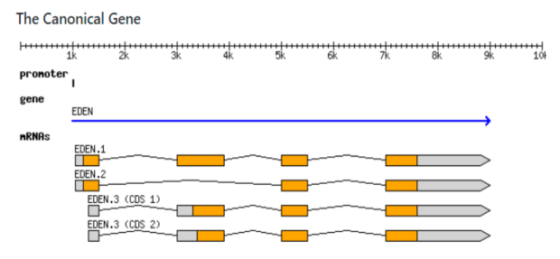
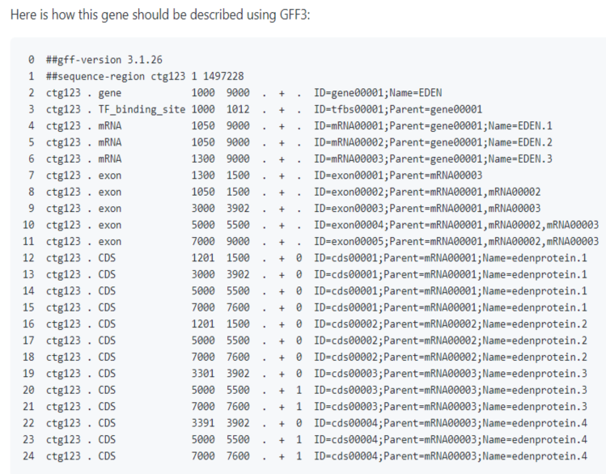
Formato del fichero GFF (General feature format)
Formato standard para describir genes o transcritos…. 9 col, tab-delimited, plain text files
seqid
source
type
start
end
score
strand
phase
atributes
https://github.com/The-Sequence-Ontology/Specifications/blob/master/gff3.md

Slide 26
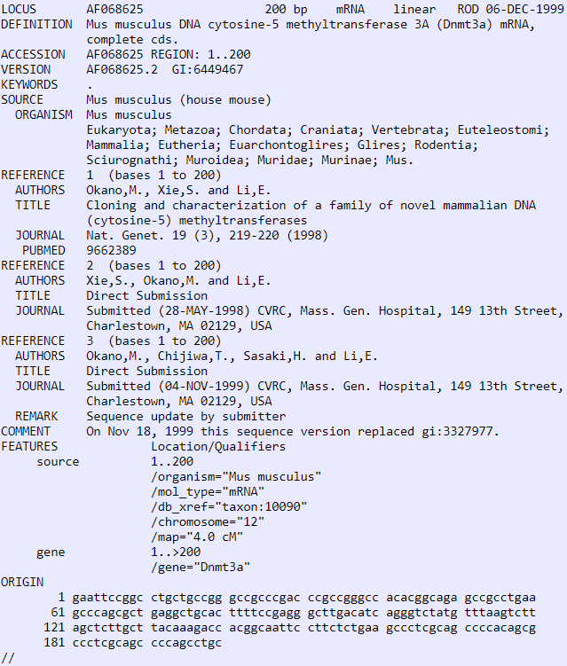
Annotation format: gbk
FEATURES
LOCUS – Annotated sequence
DEFINITION
ACCESION
FEATURES
source
gene
CDS
Locus tag
function
Product
protein_id
Translation (sequence)
Notes:
Column 9 Tags
Column 9 tags have predefined meanings:
ID
Indicates the unique identifier of the feature. IDs must be unique within the scope of the GFF file.
Name
Display name for the feature. This is the name to be displayed to the user. Unlike IDs, there is no requirement that the Name be unique within the file.
Alias
A secondary name for the feature. It is suggested that this tag be used whenever a secondary identifier for the feature is needed, such as locus names and accession numbers. Unlike ID, there is no requirement that Alias be unique within the file.
Parent
Indicates the parent of the feature. A parent ID can be used to group exons into transcripts, transcripts into genes, and so forth. A feature may have multiple parents. Parent can *only* be used to indicate a partof relationship.
Target
Indicates the target of a nucleotide-to-nucleotide or protein-to-nucleotide alignment. The format of the value is "target_id start end [strand]", where strand is optional and may be "+" or "-". If the target_id contains spaces, they must be escaped as hex escape %20.
Gap
The alignment of the feature to the target if the two are not collinear (e.g. contain gaps). The alignment format is taken from the CIGAR format described in the Exonerate documentation. http://cvsweb.sanger.ac.uk/cgi-bin/cvsweb.cgi/exonerate?cvsroot=Ensembl). See the GFF3 specification for more information.
Derives_from
Used to disambiguate the relationship between one feature and another when the relationship is a temporal one rather than a purely structural "part of" one. This is needed for polycistronic genes. See the GFF3 specification for more information.
Note
A free text note.
Dbxref
A database cross reference. See the GFF3 specification for more information.
Ontology_term
A cross reference to an ontology term. See the GFF3 specification for more information.

Slide 27
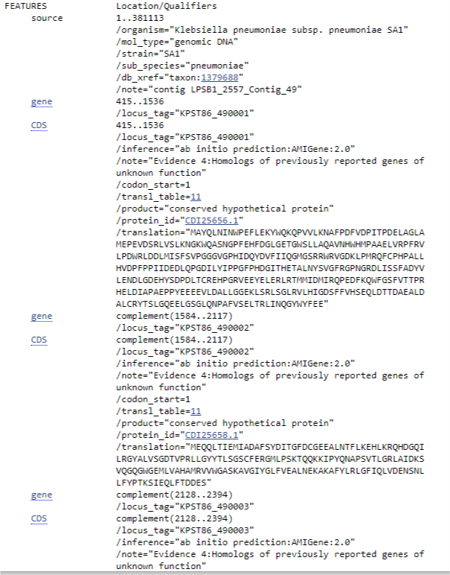
Annotation format: gbk
FEATURES
LOCUS – Annotated sequence
DEFINITION
ACCESION
FEATURES
source
gene
CDS
Locus tag
function
Product
protein_id
Translation (sequence)
Notes:
Column 9 Tags
Column 9 tags have predefined meanings:
ID
Indicates the unique identifier of the feature. IDs must be unique within the scope of the GFF file.
Name
Display name for the feature. This is the name to be displayed to the user. Unlike IDs, there is no requirement that the Name be unique within the file.
Alias
A secondary name for the feature. It is suggested that this tag be used whenever a secondary identifier for the feature is needed, such as locus names and accession numbers. Unlike ID, there is no requirement that Alias be unique within the file.
Parent
Indicates the parent of the feature. A parent ID can be used to group exons into transcripts, transcripts into genes, and so forth. A feature may have multiple parents. Parent can *only* be used to indicate a partof relationship.
Target
Indicates the target of a nucleotide-to-nucleotide or protein-to-nucleotide alignment. The format of the value is "target_id start end [strand]", where strand is optional and may be "+" or "-". If the target_id contains spaces, they must be escaped as hex escape %20.
Gap
The alignment of the feature to the target if the two are not collinear (e.g. contain gaps). The alignment format is taken from the CIGAR format described in the Exonerate documentation. http://cvsweb.sanger.ac.uk/cgi-bin/cvsweb.cgi/exonerate?cvsroot=Ensembl). See the GFF3 specification for more information.
Derives_from
Used to disambiguate the relationship between one feature and another when the relationship is a temporal one rather than a purely structural "part of" one. This is needed for polycistronic genes. See the GFF3 specification for more information.
Note
A free text note.
Dbxref
A database cross reference. See the GFF3 specification for more information.
Ontology_term
A cross reference to an ontology term. See the GFF3 specification for more information.

Slide 28
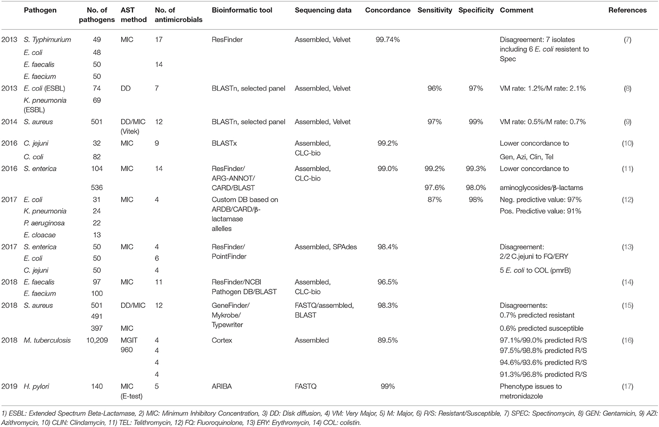
Resistance prediction using WGS
Hendrisken et al. Frontiers in Microbiology. 2019.
Concordance between phenotypic susceptibility testing and WGS based predicted antimicrobial resistance

Slide 29
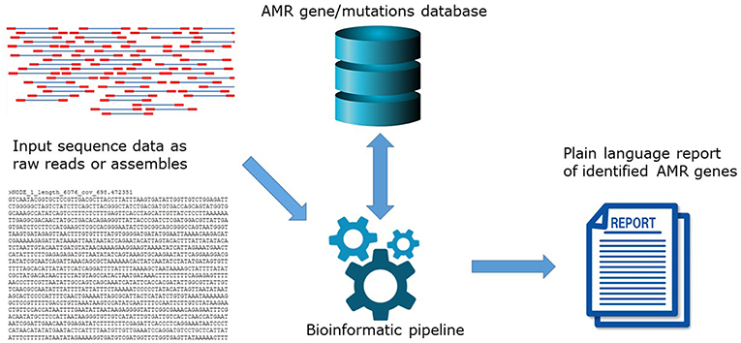
Resistance prediction using WGS
Hendrisken et al. Frontiers in Microbiology. 2019.

Slide 30
Resistance prediction using WGS
Hendrisken et al. Frontiers in Microbiology. 2019.
Huge list here: https://www.frontiersin.org/files/Articles/478239/fpubh-07-00242-HTML/image_m/fpubh-07-00242-t002.jpg
Software | Type
SRST2 | Mapping
Ariba | Mapping + assembly
ABRICATE | Assembly
ResFinder | Assembly

Slide 31
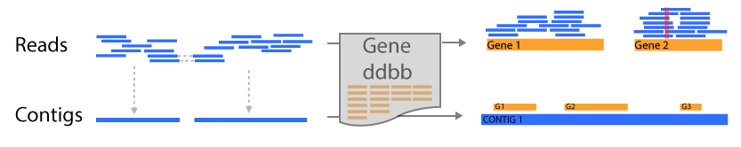
Mapping vs Assembly
Functional annotation based on mapping (srst2)
Pro: more resolutive / high quality ddbb
Con: Unable to locate genes / no ab initio annotation
Functional annotation based on assembly (Resfinder)
Pro: genes are located / related
Depend on assembly (close to repetitive regions)

Slide 32
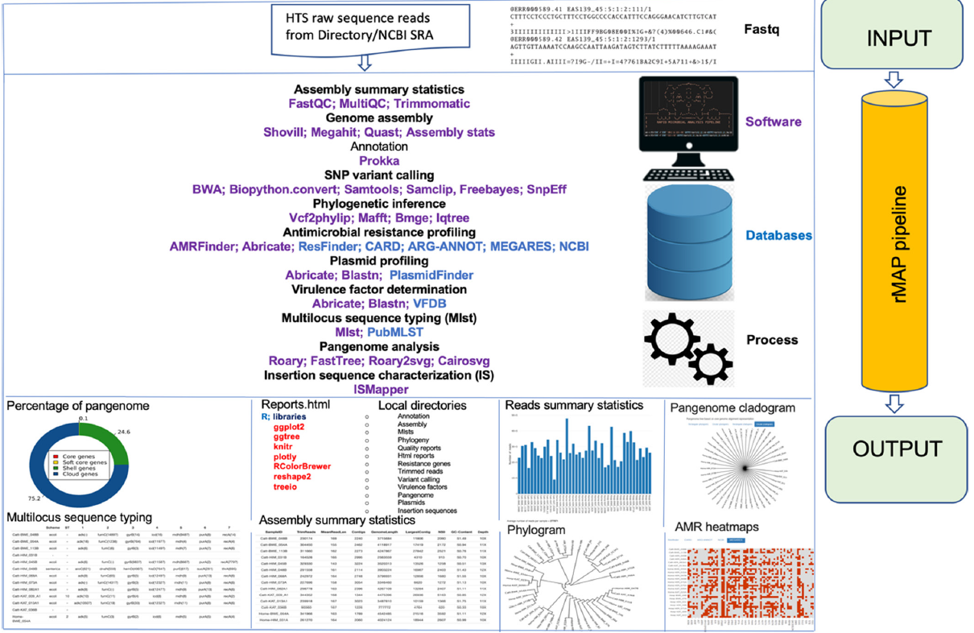
rMAP - rapid microbial analysis pipeline- for ESKAPE bacterial group wgs data
The resistomes of ESKAPE pathogens (Enterococcus faecium, Staphylococcus aureus, Klebsiella pneumoniae, Acinetobacter baumannii, Pseudomonas aeruginosa and Enterobacter species)
Sserwadda & Mboowa, Microbiology, 2021

Slide 33
Annotation visualization using PlasmidID
Automatic annotation
Prokka
DDBB plasmid
Contigs
Gff to bed
Specific annotation
BLAST+
ABR & REP
User input FASTA

Slide 34
Annotation using PlasmidID

Slide 35
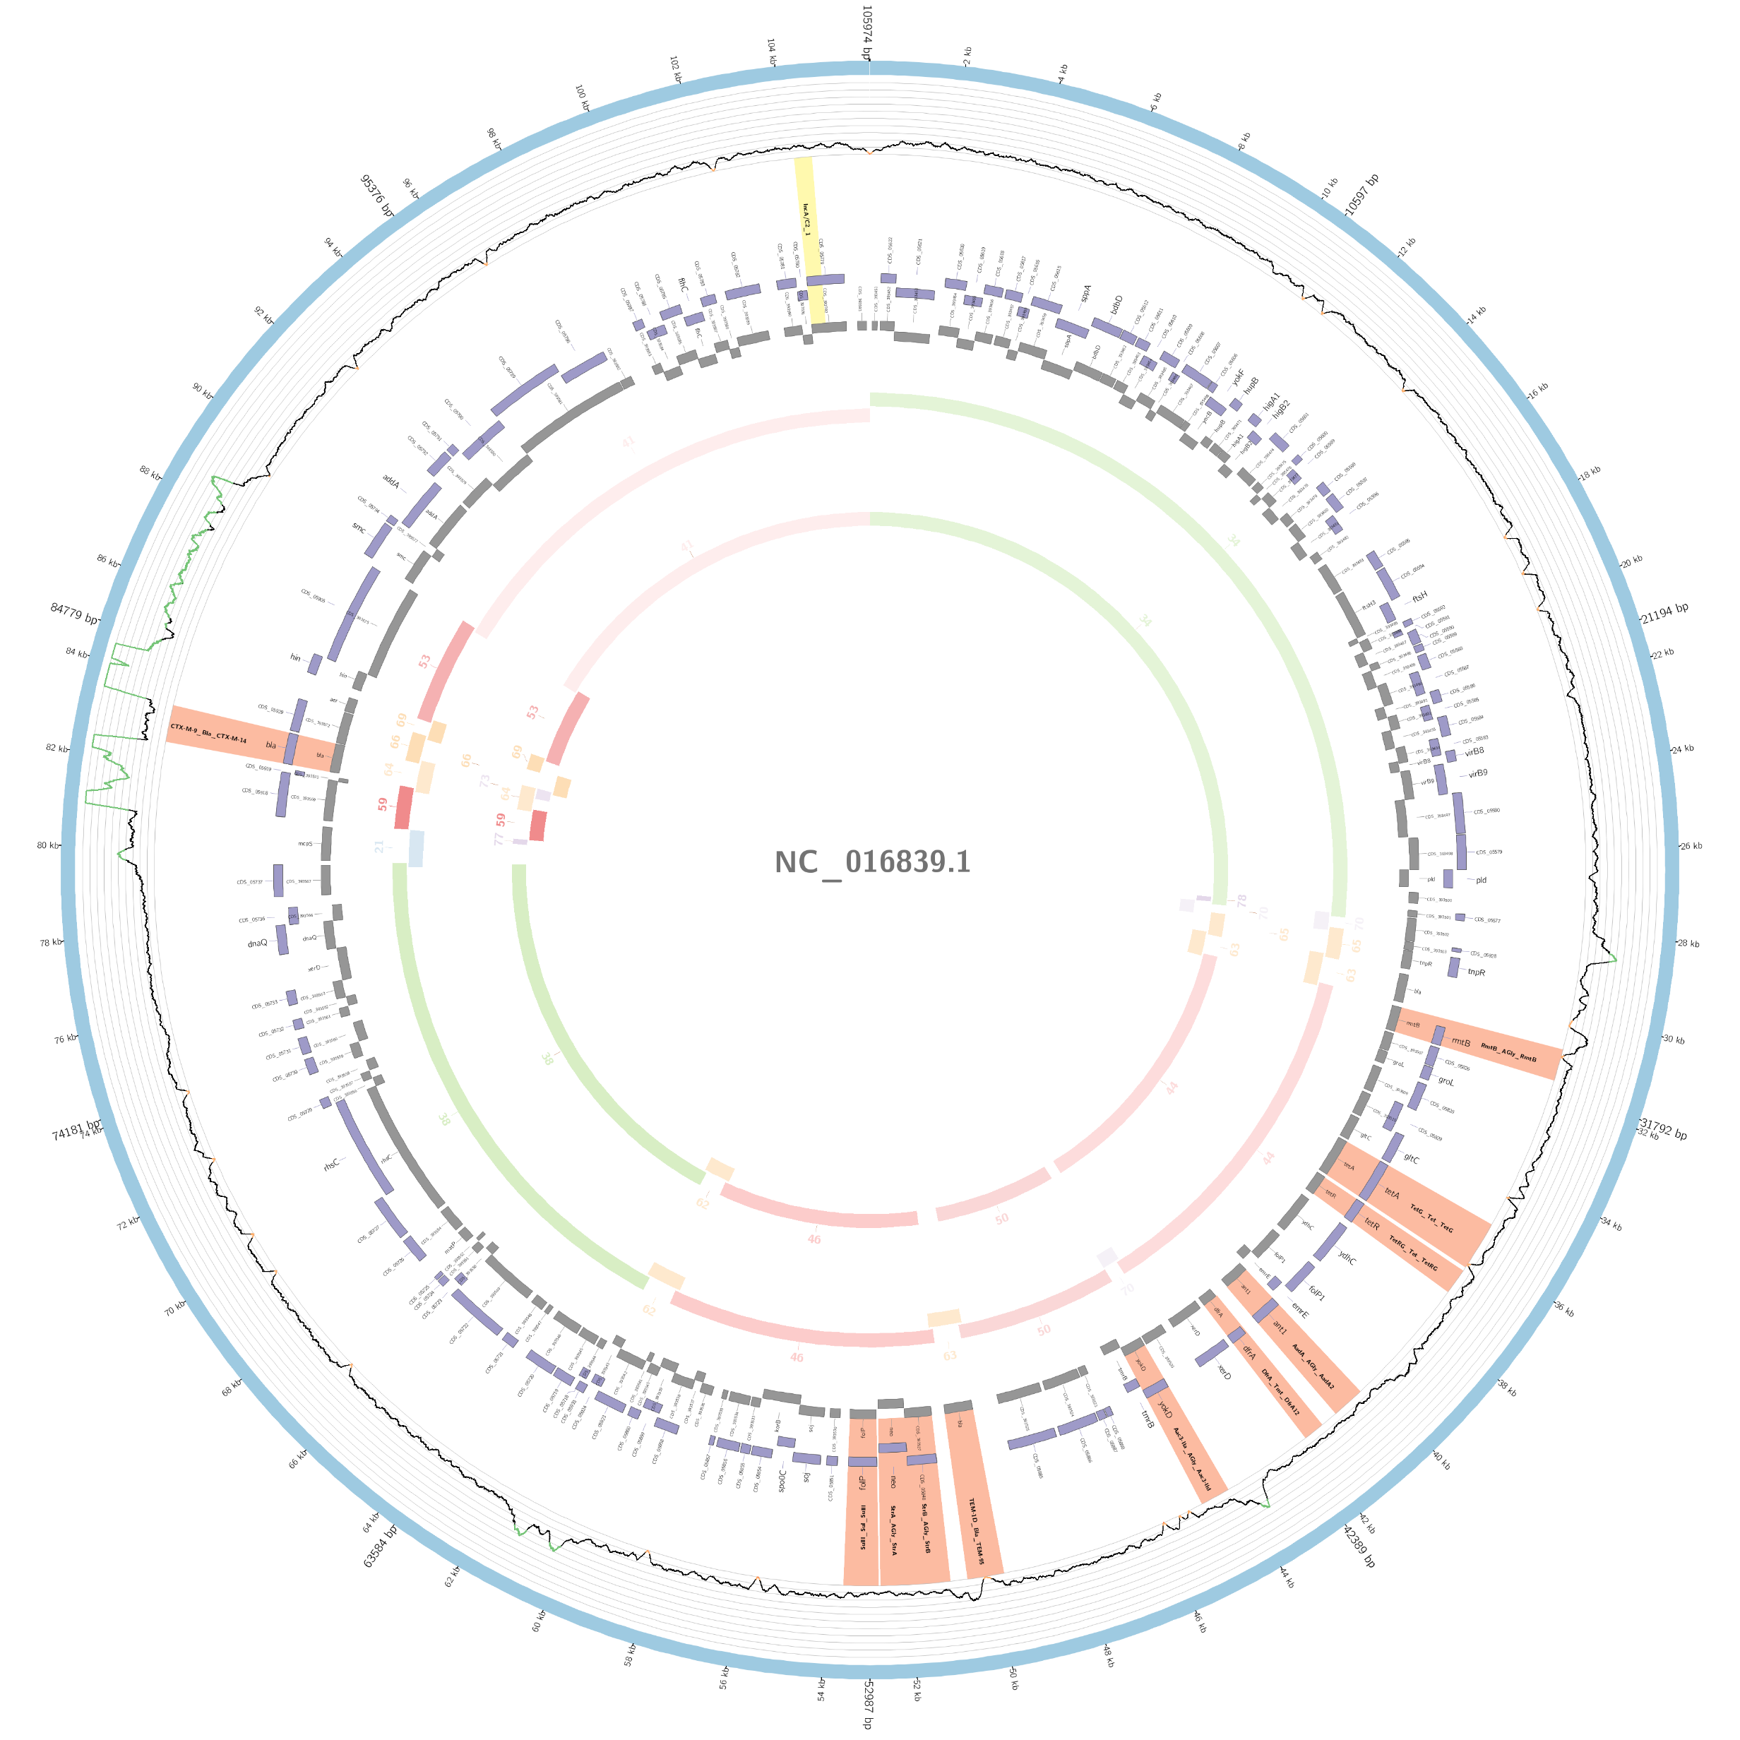
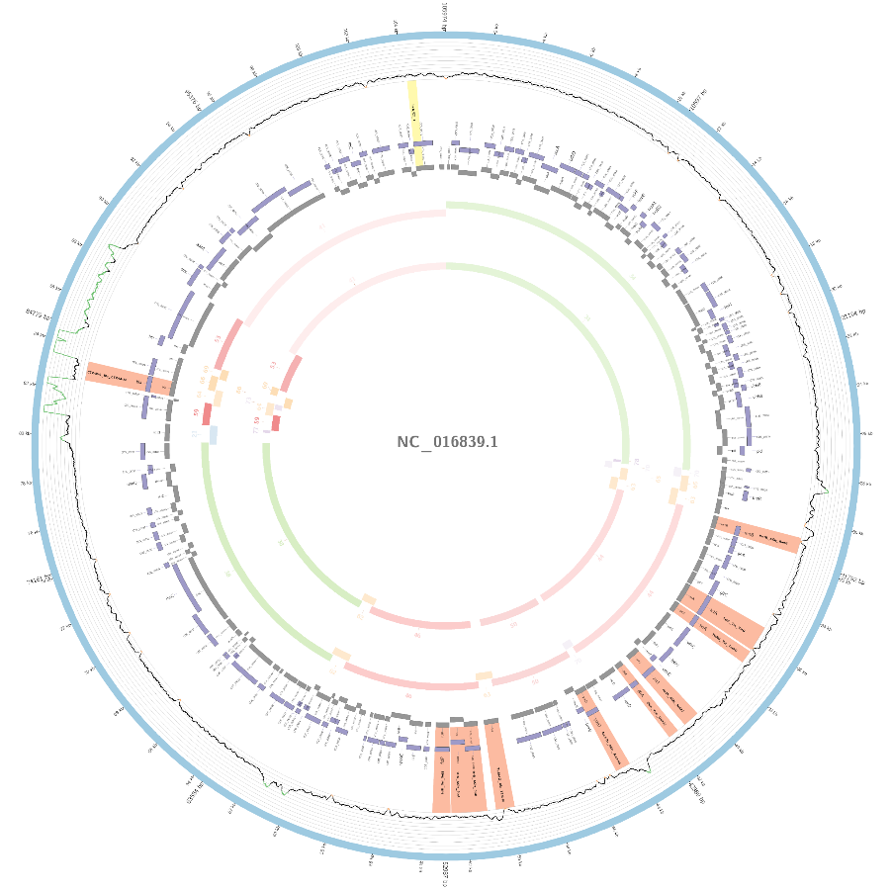
Annotation using PlasmidID
Annotation on short contigs

Slide 36
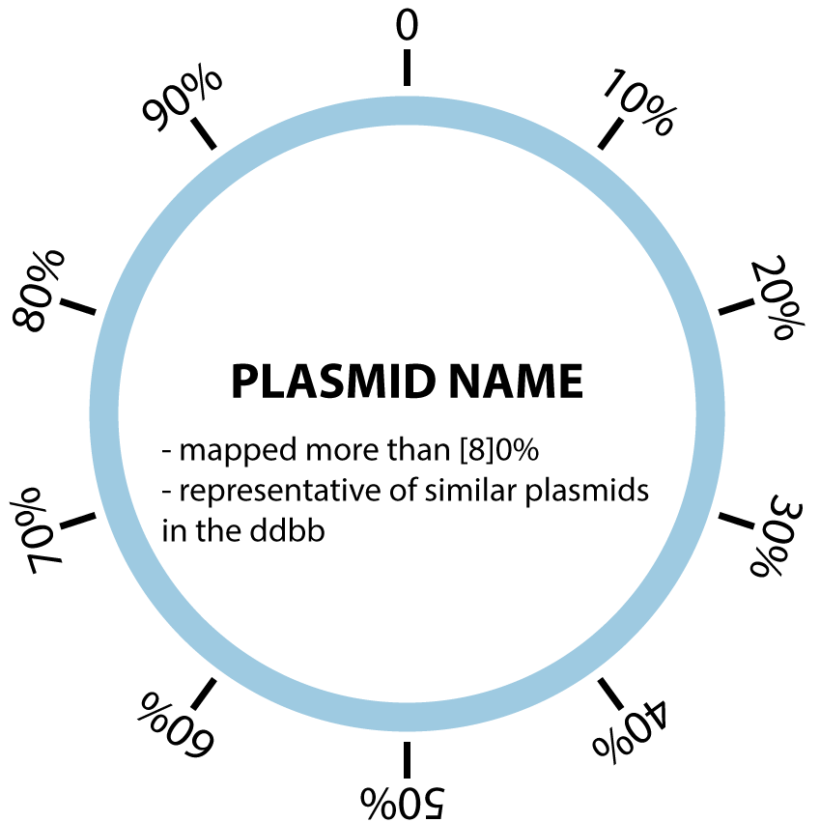
Understanding the image: track by track
Plasmid Track

Slide 37
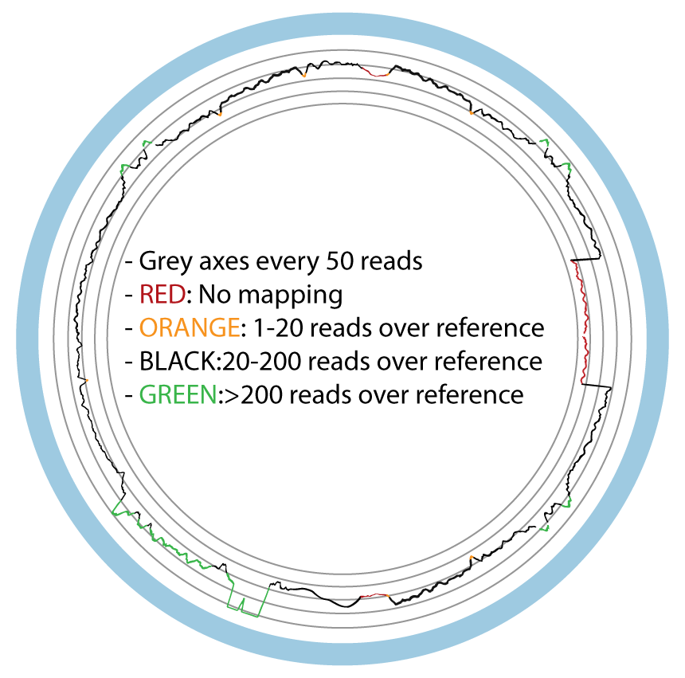
Understanding the image: track by track
Coverage Track

Slide 38
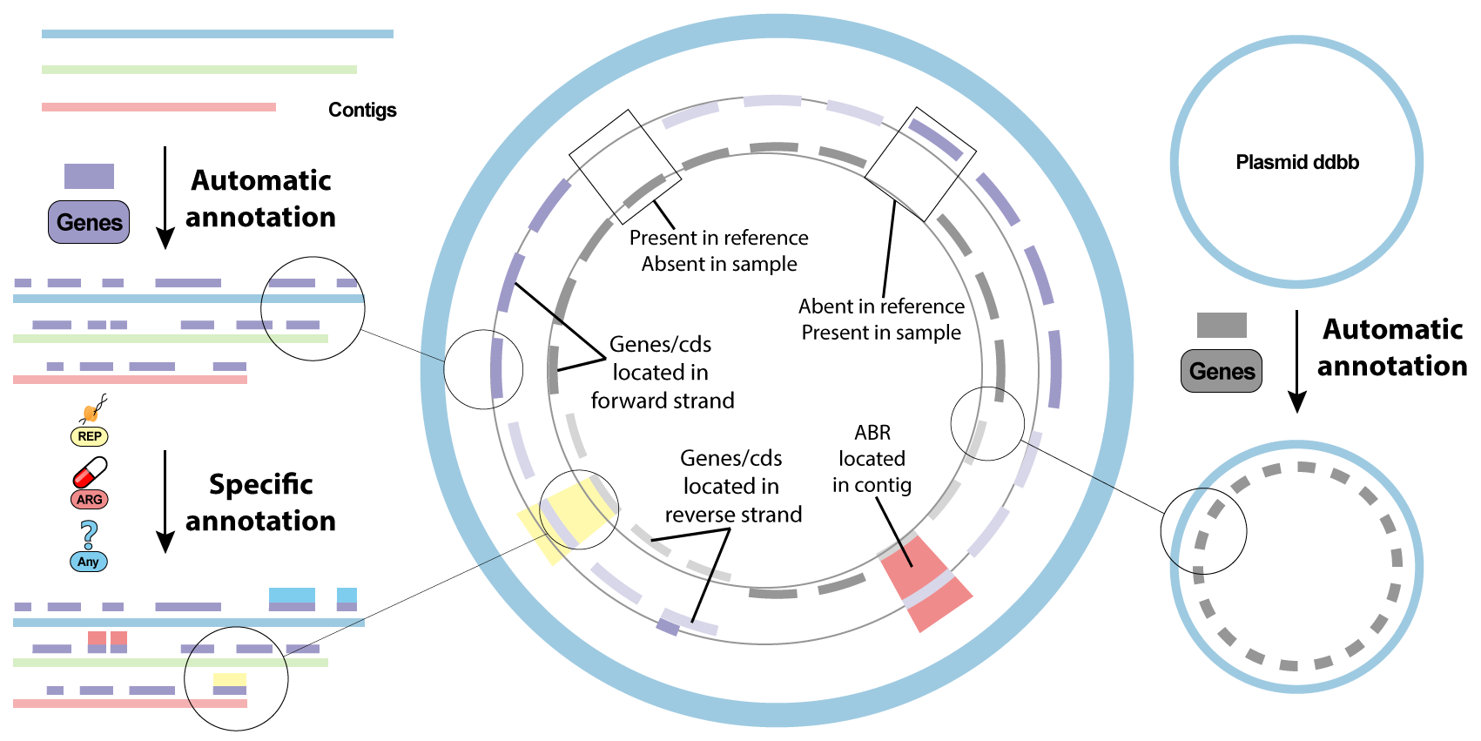
Understanding the image: track by track
Annotation Track

Slide 39
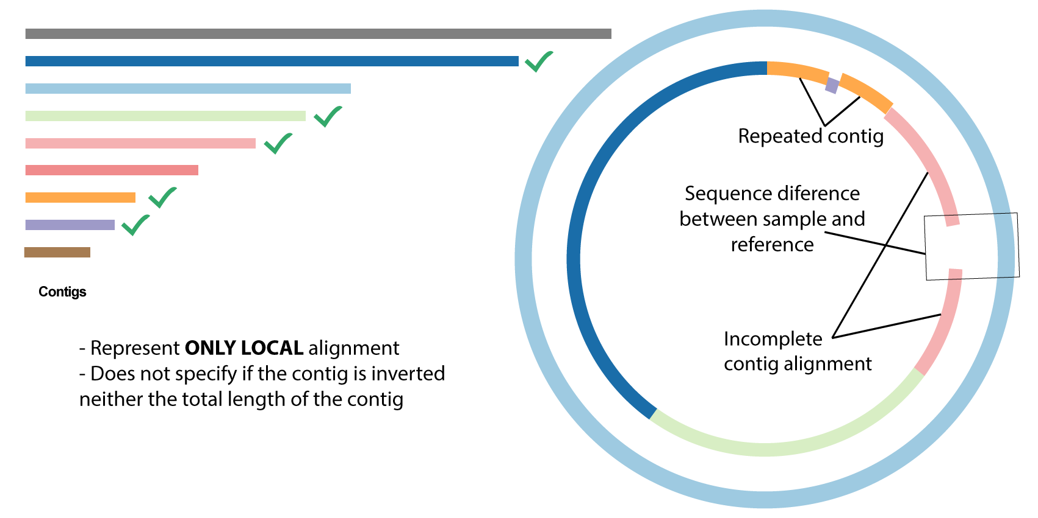
Understanding the image: track by track
Contig Track

Slide 40
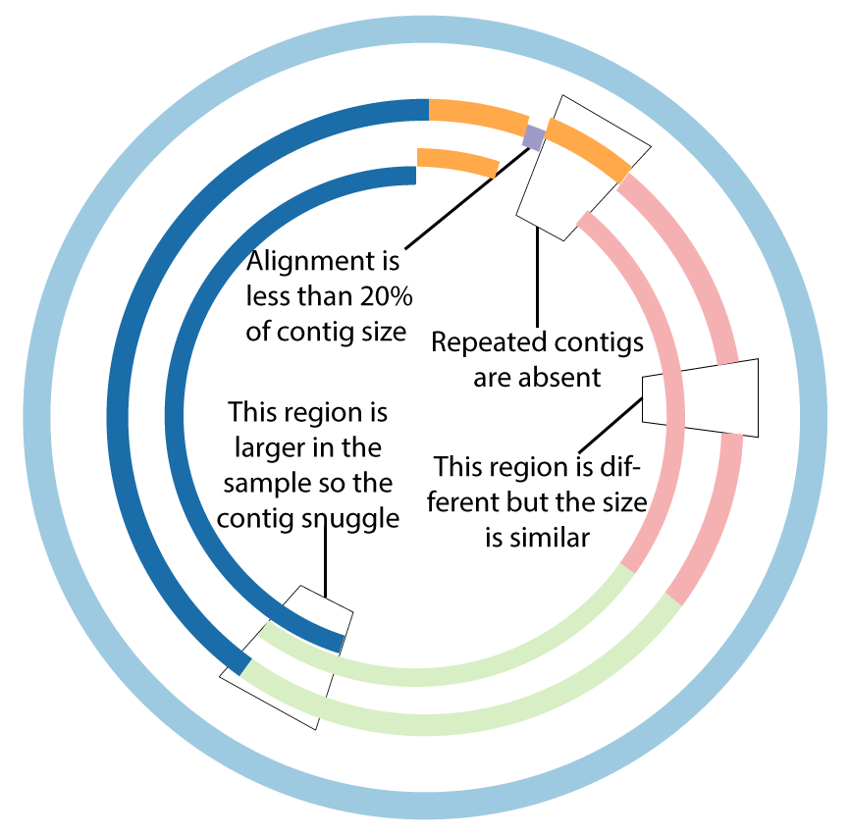
Understanding the image: track by track
Complete contig Track

Slide 41
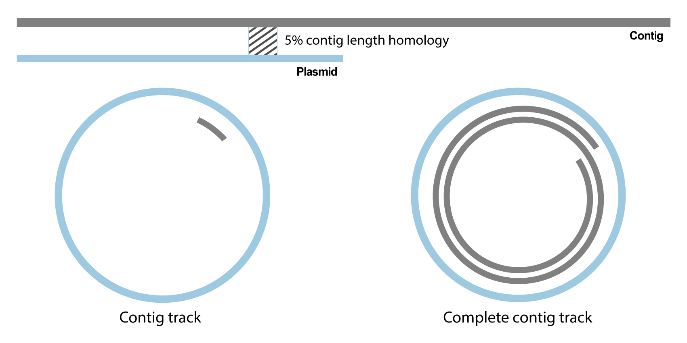
Understanding the image: track by track
Complete contig Track

Slide 42
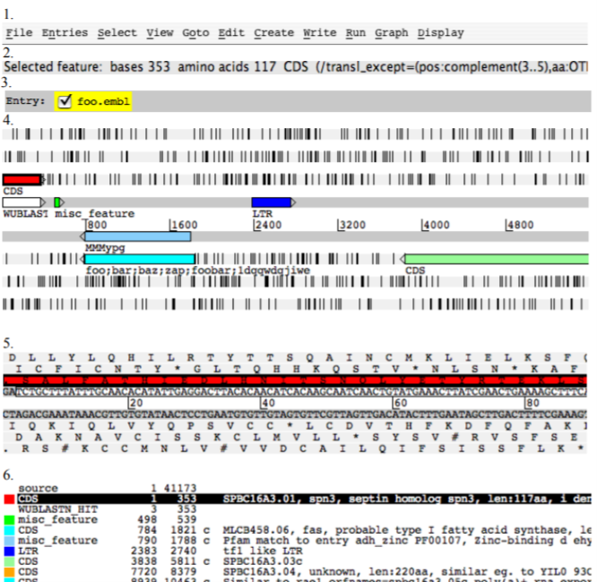
Manual annotation: Artemis
Artemis is a DNA sequence viewer and annotation tool that allows visualisation of sequence features and the results of analyses within the context of the sequence, and its six-frame translation.

Slide 43
Thanks for your attention!

